Slide 1
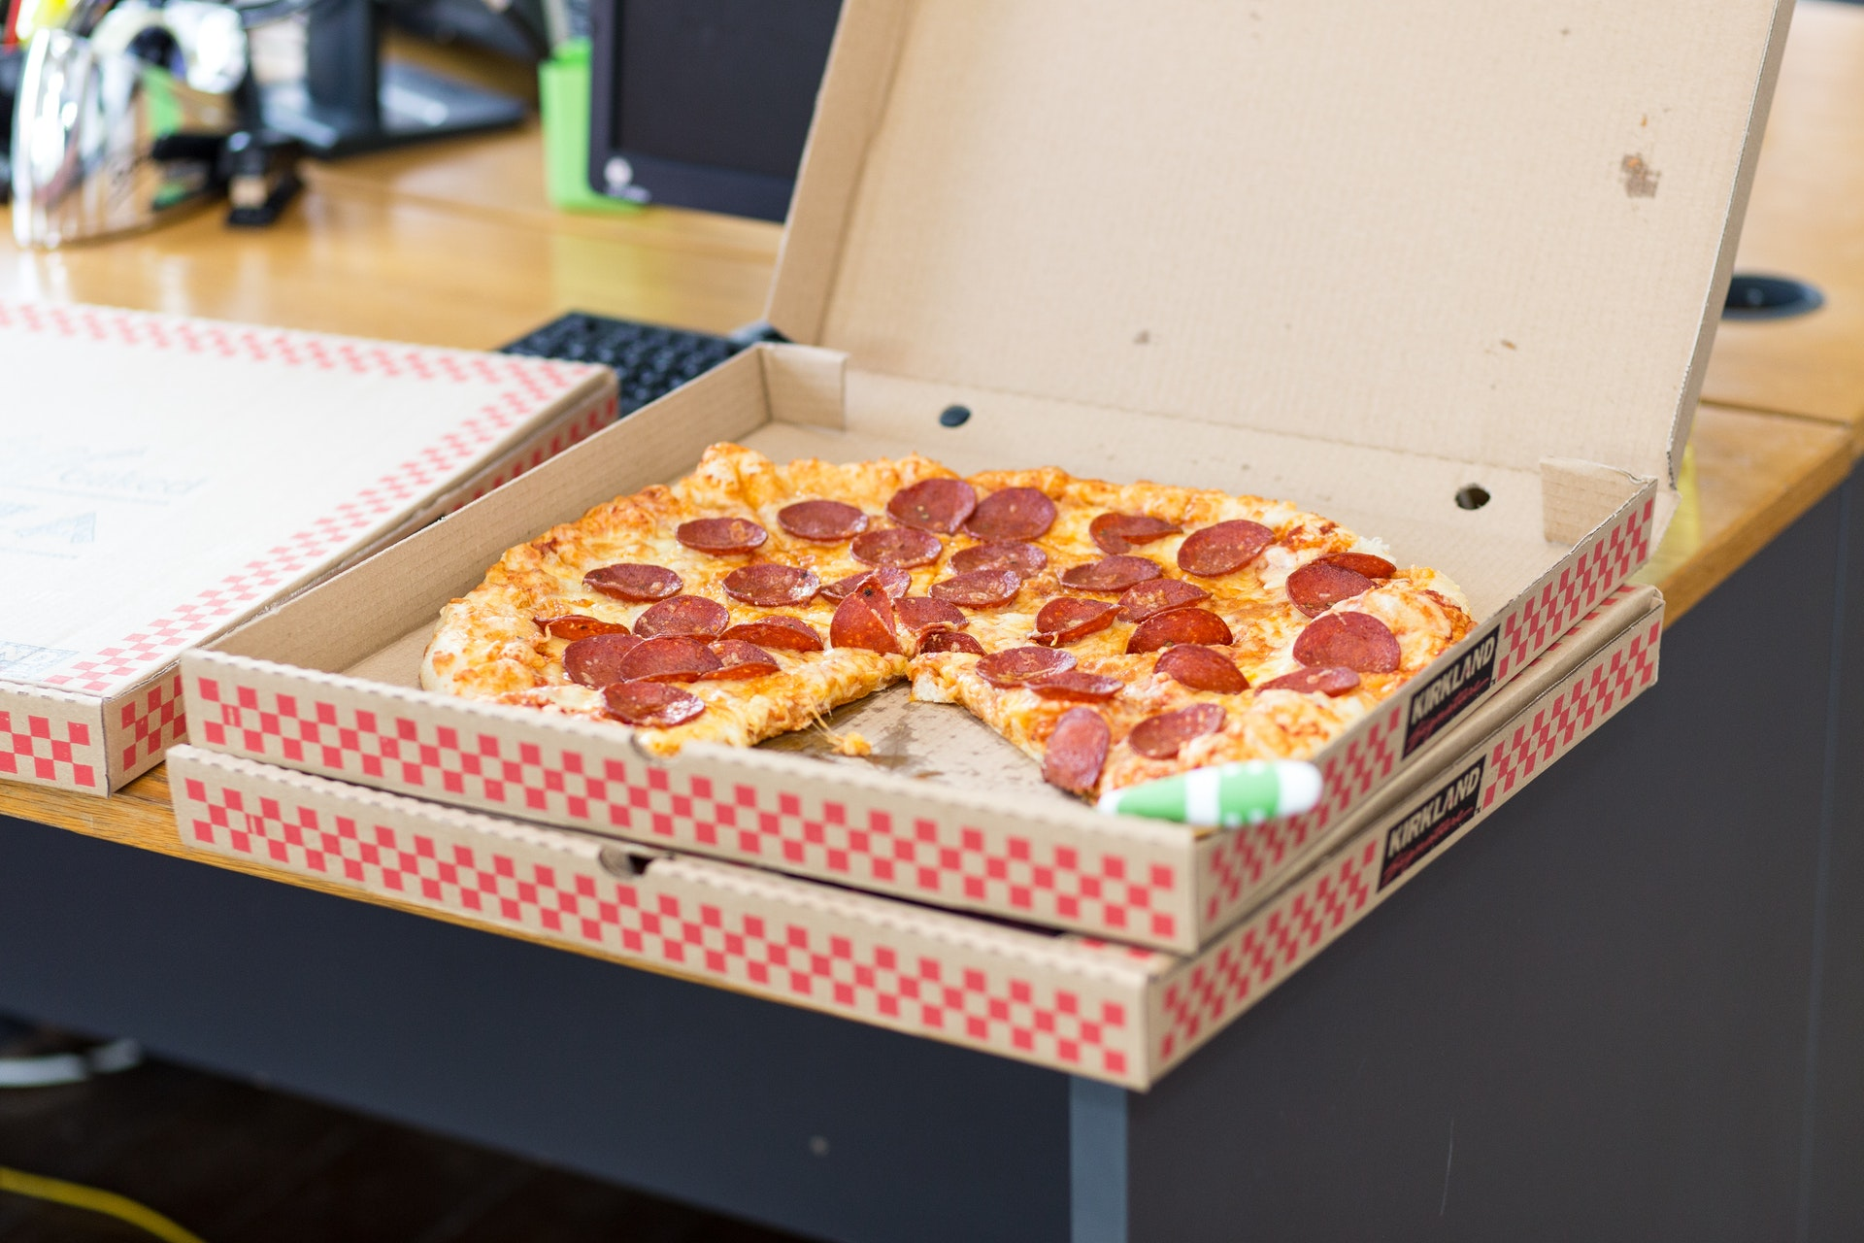
Pizza Comes in a Box
Separation
Boxes tell us where each pizza starts and ends
We Don’t Eat the Box
It’s disgusting.
We Eat Pizza
But without the box, the pizzas would be disgusting.
Details
Boxes tell us about the pizza

Slide 2
Protocols are like [Pizza] Boxes
Version Info
What is this?
<!DOCTYPE html>
<html>
<head>
<meta charset='utf-8'>
<meta http-equiv='X-UA-Compatible' content='IE=edge'>
<title>Page Title</title>
<meta name='viewport' content='width=device-width, initial-scale=1'>
</head>
<body>
This is the part you can see.
</body>
</html>
Meta-Data
Information about the content.
Start
Where do we begin?
End
Body
Crucial! Where do we stop?
The part the user actually “consumes.”
http://www.evolutionoftheweb.com/

